Slide 1
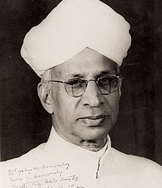
Happy Teacher’s Day
5th September
Birth Anniversary of Dr. Sarvepalli Radhakrishnan

Slide 2
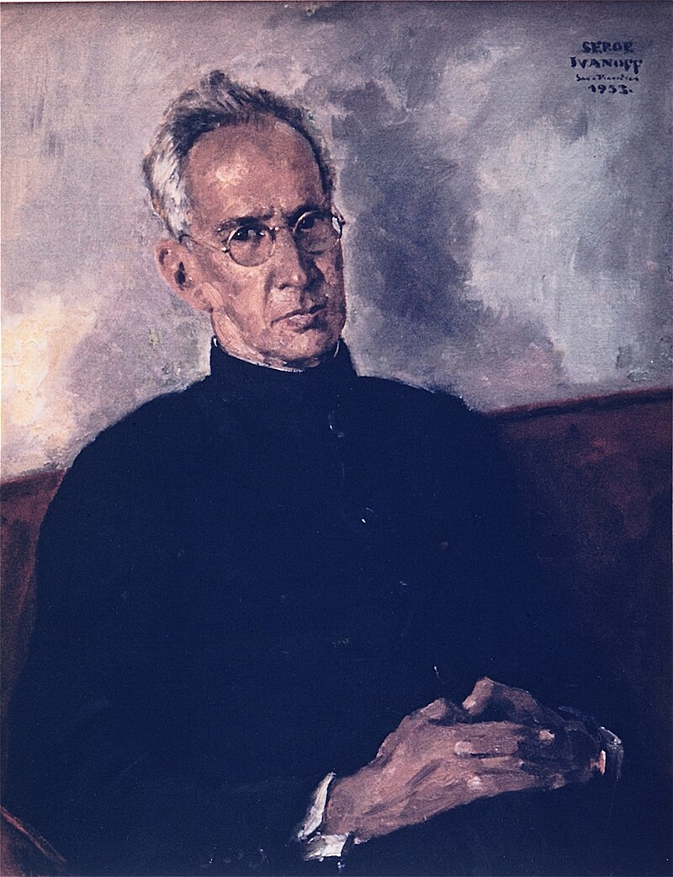
Teacher’s Day is celebrated to mark the Birth Anniversary Dr. Sarvepalli Radhakrishnan
The Second President and First Vice President of Our Country

Slide 3
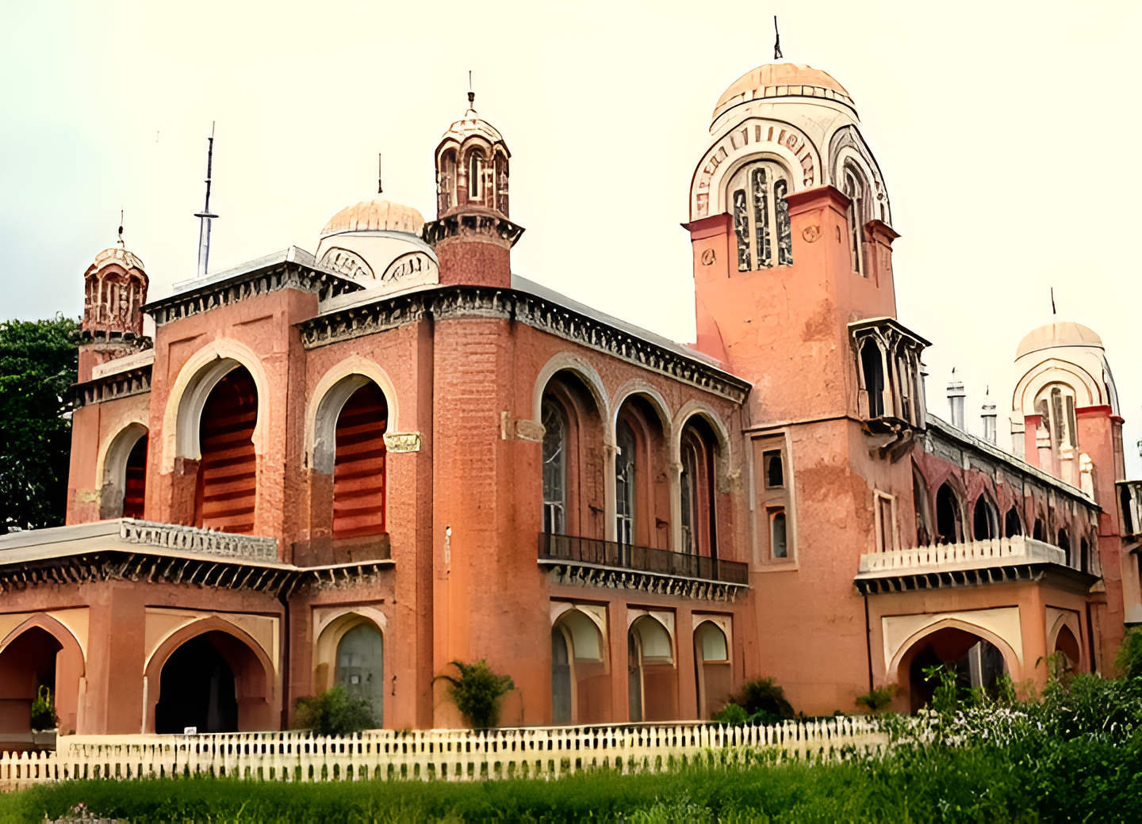
Dr. Sarvepalli Radhakrishnan
Dr. Sarvepalli Radhakrishnan was a distinguished Indian philosopher and educator, who served as the second President of India and was a key figure in promoting Indian philosophy and education. His profound contributions to philosophy and his emphasis on education earned him widespread respect and recognition.

Slide 4
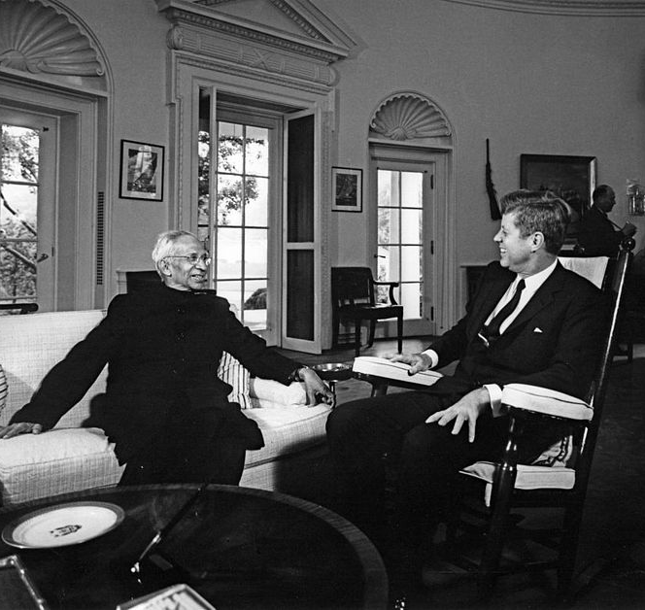
His Early Life and Education
Dr. Sarvepalli Radhakrishnan was born on September 5, 1888, in a small village in Tamil Nadu, India, into a modest family. Despite financial constraints, he excelled academically and earned scholarships to study at Presidency College, Chennai, and later at the University of Madras. His early struggles with poverty and limited resources were overcome through his exceptional intellect and dedication. Radhakrishnan's perseverance led him to become a prominent scholar and educator in Indian philosophy.

Slide 5
His Work Life
Dr. Sarvepalli Radhakrishnan, as India's second President (1962-1967), played a pivotal role in strengthening democratic institutions and enhancing India's international stature. His tenure saw significant efforts in promoting national unity and educational reform. Additionally, he represented India on the global stage, advocating for peace and fostering diplomatic relations. His leadership left a lasting impact on both domestic and international fronts.

Slide 6
Contribution Towards India
Dr. Sarvepalli Radhakrishnan made significant contributions to social work and education by advocating for reforms that integrated traditional values with modern knowledge. He emphasized the importance of cultural heritage in education and supported the development of higher education institutions. His efforts profoundly impacted educational policies and practices, shaping the educational system in India.

Slide 7
Our Teachers Our Shapers
Our Lovely Teachers
They are one of the most important person in our society,
moulding the clay for the future.

Slide 8
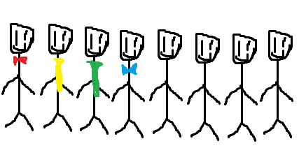
Our Lovely Teachers
They are one of the most important person in our society,
moulding the clay for the future.

Slide 9
- Mustafa Kemal Atatürk
"A good teacher is like a candle—it consumes itself to light the way for others."

Slide 10
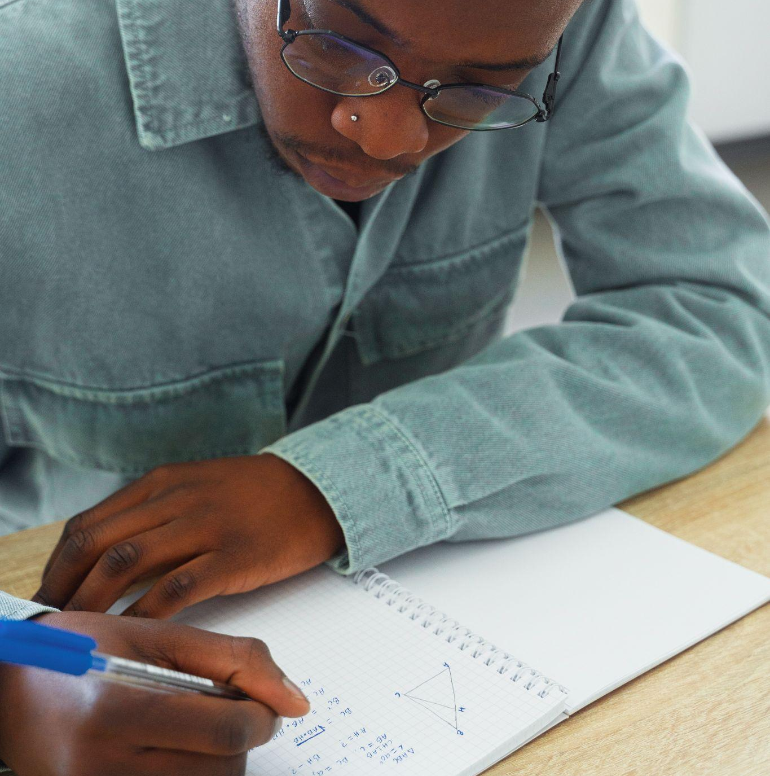
Our Principal , Vice Principal and Sister
They are the last craftsman of our life baking the moulded to an art, seen nothing as before.

Slide 11
- Albert Einstein
"It is the supreme art of the teacher to awaken joy in creative expression and knowledge."

Slide 12
Our Teachers’ Role Models
Our Lovely Teachers
They are one of the most important person in our society,
moulding the clay for the future.

Slide 13
Gauri Ma’am
One of our most experienced teachers, with over 25 years in the field, is the cornerstone of our school. Her deep expertise and unwavering commitment to education set a high standard, inspiring other teachers to pursue excellence in their own classrooms.

Slide 14
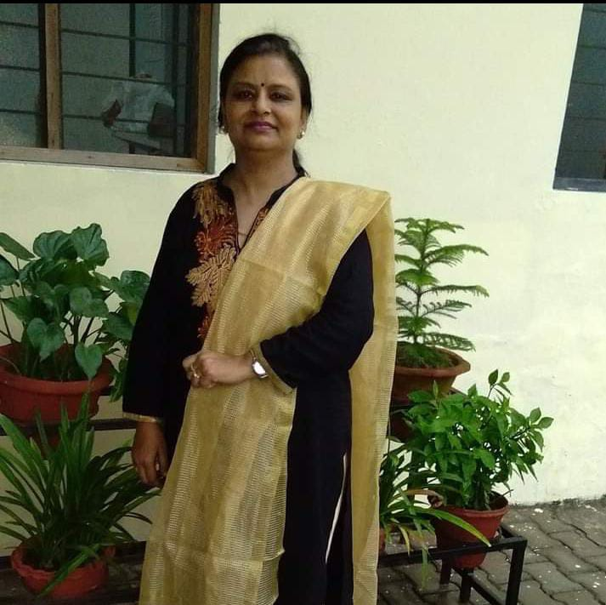
Jayti Ma’am
Another teacher is known for her disciplined yet compassionate approach. Her ability to connect with students on a personal level and consistently bring out their best serves as a model of patience and resilience for her colleagues, guiding them in their professional growth.

Slide 15
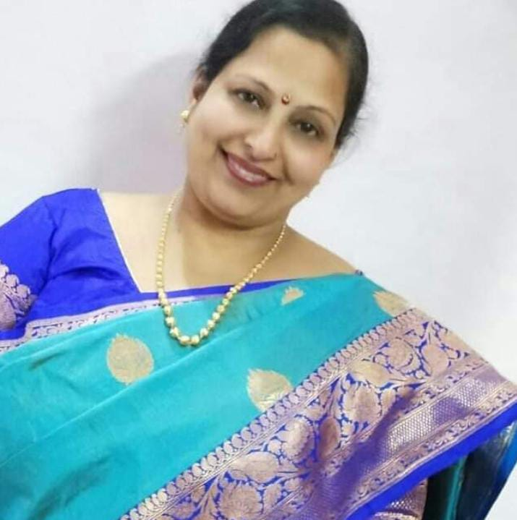
Sonia Ma’am
A teacher who embodies creativity and innovation plays a crucial role in our school. Her enthusiasm for teaching and skillful integration of technology into lessons motivate other educators to explore new methods, fostering a dynamic and engaging learning environment across the school.

Slide 16
Thank You!
-Aditya R. Yadav,
Aryan Rai

Slide 17
Alternative resources
Here’s an assortment of alternative resources whose style fits the one of this template:
Vectors
Fun background with hand drawn school elements

